Slide 1

Data Analytical Engines

Slide 2






Explore, transform, and visualize data in the lakehouse
Tools and techniques to explore and transform data:
Apache Spark
    Notebooks
    Spark Job Definitions
SQL analytics endpoint
Dataflows Gen2
Data Pipelines
Visualize lakehouse data using Power BI
Notes:
After loading data into the lakehouse, you can use various tools and techniques to explore and transform it, including:
Apache Spark: Each Fabric lakehouse can use Spark pools through Notebooks or Spark Job Definitions to process data in files and tables in the lakehouse using Scala, PySpark, or Spark SQL.
Notebooks: Interactive coding interfaces in which you can use code to read, transform, and write data directly to the lakehouse as tables and/or files.
Spark Job Definitions: On-demand or scheduled scripts that use the Spark engine to process data in the lakehouse.
SQL analytics endpoint: Each lakehouse includes a SQL analytics endpoint through which you can run Transact-SQL statements to query, filter, aggregate, and otherwise explore data in lakehouse tables.
Dataflows Gen2: In addition to using a dataflow to ingest data into the lakehouse, you can create a dataflow to perform subsequent transformations through Power Query, and optionally land transformed data back to the Lakehouse.
Data Pipelines: Orchestrate complex data transformation logic that operates on data in the lakehouse through a sequence of activities (such as dataflows, Spark jobs, and other control flow logic).

Slide 3

Apache Spark

Slide 4



Matei Zaharia
Ali Ghodsi
Ion Stoica
Apache Spark is at the heart of the Fabric platform and is the technology powering compute clusters and SQL warehouses. Fabric is an optimized platform for Apache Spark, providing an efficient and simple platform for running Apache Spark workloads.
The Databricks company was founded by the original creators of Apache Spark. As an open source software project, Apache Spark has committers from many top companies, including Databricks.

Slide 5
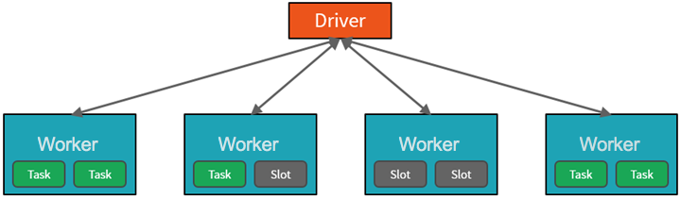
How Azure manages cluster resources ( Driver and Worker Nodes)
Cluster architecture consists of driver and worker nodes:
The driver node sends work to the worker nodes and instructs them to pull data from a specified data source.
This driver program contains the main loop for the program and creates distributed datasets on the cluster, then applies operations to those datasets. Driver programs access Apache Spark through a SparkSession object regardless of deployment location.
Driver program coordinates the overall distributed work using a SparkSession object
  Work submitted to the cluster is split into as many independent jobs as needed. This is how work is distributed across the Cluster's nodes. Jobs are further subdivided into tasks.
  These partitions are the unit of work for each slot.
  Workers process subsets of the data in parallel
Driver program contains the main loop for the program and creates distributed datasets on the cluster
May be one instance per node. Depends on No. of Nodes…parallelization is the slot
Microsoft Azure manages the cluster
Notes:
To gain a better understanding of how to process and analyze data with Apache Spark in Azure Databricks, it's important to understand the underlying architecture.
High-level overview
From a high level, the Azure Databricks service launches and manages Apache Spark clusters within your Azure subscription.
Apache Spark clusters are groups of computers that are treated as a single computer and handle the execution of commands issued from notebooks.
Clusters enable processing of data to be parallelized across many computers to improve scale and performance.
They consist of a Spark driver and worker nodes. The driver node sends work to the worker nodes and instructs them to pull data from a specified data source.
In Databricks, the notebook interface is typically the driver program. This driver program contains the main loop for the program and creates distributed datasets on the cluster, then applies operations to those datasets. Driver programs access Apache Spark through a SparkSession object regardless of deployment location.
Microsoft Azure manages the cluster, and auto-scales it as needed based on your usage and the setting used when configuring the cluster. Auto-termination can also be enabled, which allows Azure to terminate the cluster after a specified number of minutes of inactivity.
Spark jobs in detail
Work submitted to the cluster is split into as many independent jobs as needed. This is how work is distributed across the cluster's nodes. Jobs are further subdivided into tasks. The input to a job is partitioned into one or more partitions. These partitions are the unit of work for each slot. In between tasks, partitions may need to be reorganized and shared over the network.
The secret to Spark's high performance is parallelism. Scaling vertically (by adding resources to a single computer) is limited to a finite amount of RAM, Threads and CPU speeds; but clusters scale horizontally, adding new nodes to the cluster as needed.
Spark parallelizes jobs at two levels:
The first level of parallelization is the executor - a Java virtual machine (JVM) running on a worker node, typically, one instance per node.
The second level of parallelization is the slot - the number of which is determined by the number of cores and CPUs of each node.
Each executor has multiple slots to which parallelized tasks can be assigned.
The JVM is naturally multi-threaded, but a single JVM, such as the one coordinating the work on the driver, has a finite upper limit. By splitting the work into tasks, the driver can assign units of work to *slots in the executors on worker nodes for parallel execution. Additionally, the driver determines how to partition the data so that it can be distributed for parallel processing. So, the driver assigns a partition of data to each task so that each task knows which piece of data it is to process. Once started, each task will fetch the partition of data assigned to it.
Jobs and stages
Depending on the work being performed, multiple parallelized jobs may be required. Each job is broken down into stages. A useful analogy is to imagine that the job is to build a house:
The first stage would be to lay the foundation.
The second stage would be to erect the walls.
The third stage would be to add the roof.
Attempting to do any of these steps out of order just doesn't make sense, and may in fact be impossible. Similarly, Spark breaks each job into stages to ensure everything is done in the right order.

Slide 6
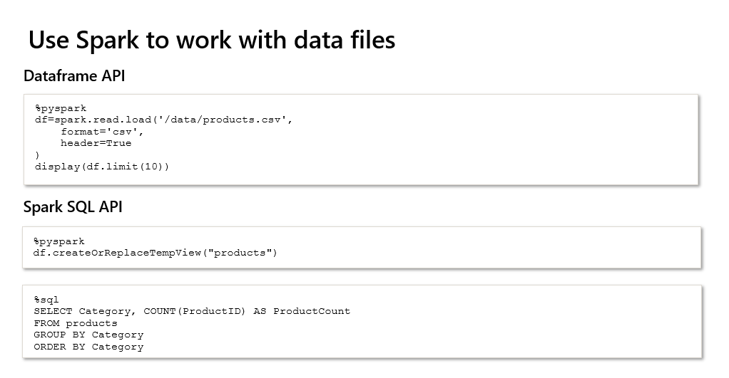

Slide 7
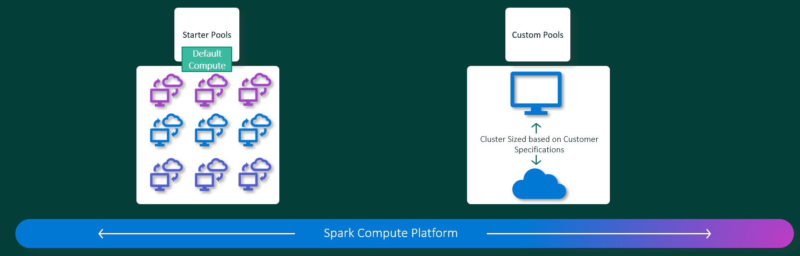
Starter Pools
Microsoft Fabric Data Engineering and Data Science experiences operate on a fully managed Apache Spark compute platform. This platform is designed to deliver unparalleled speed and efficiency. With starter pools, you can expect rapid Apache Spark session initialization, typically within 5 to 10 seconds, with no need for manual setup.
Starter pools are a fast and easy way to use Spark on the Microsoft Fabric platform within seconds. You can use Spark sessions right away, instead of waiting for Spark to set up the nodes for you, which helps you do more with data and get insights quicker.

Slide 8
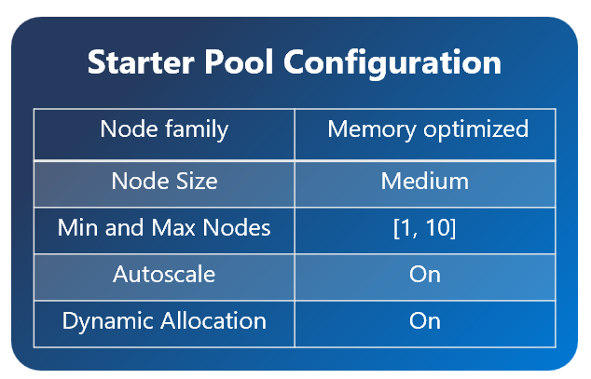
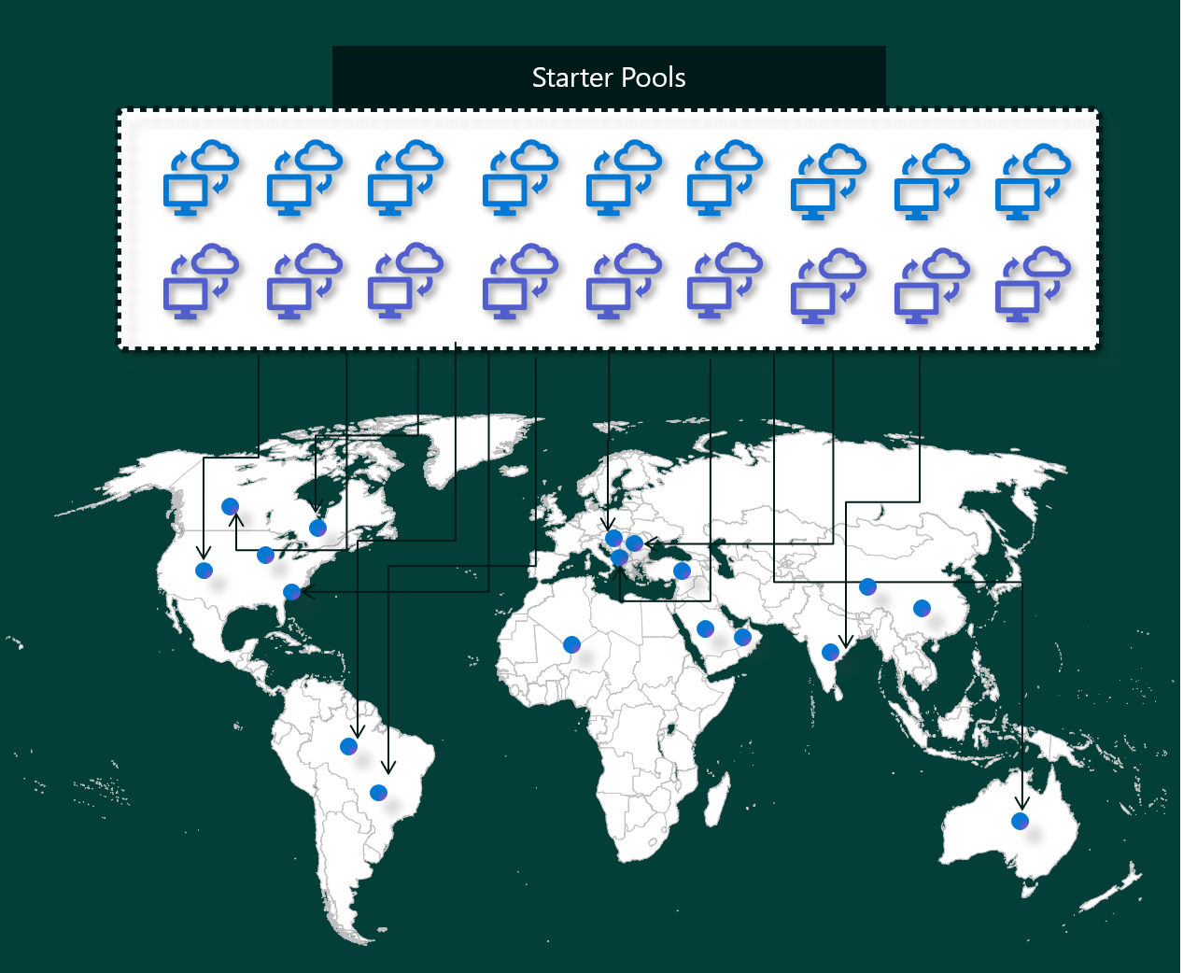
Starter pools have Apache Spark clusters that are always on and ready for your requests. They use medium nodes that dynamically scale up based on your Spark job needs.

Slide 9
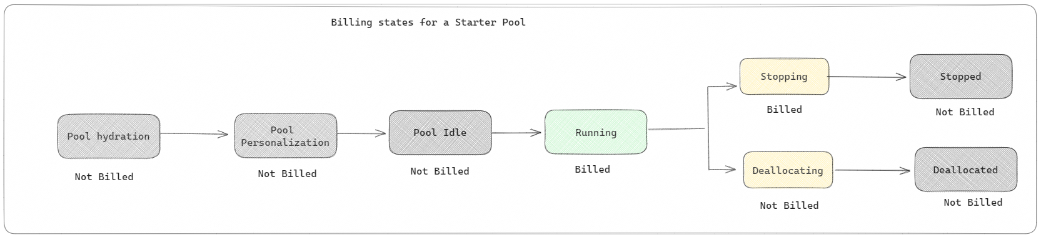
When it comes to billing and capacity consumption, you're charged for the capacity consumption when you start executing your notebook or Apache Spark job definition. You aren't charged for the time the clusters are idle in the pool.

Slide 10
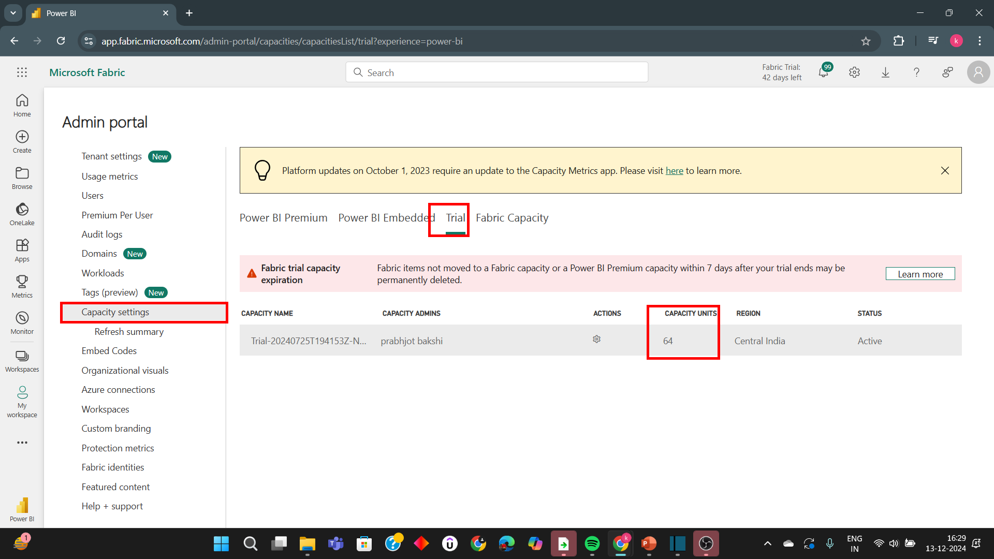
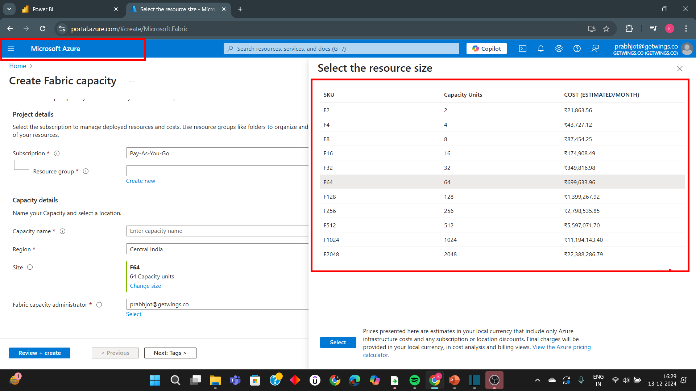

Slide 11
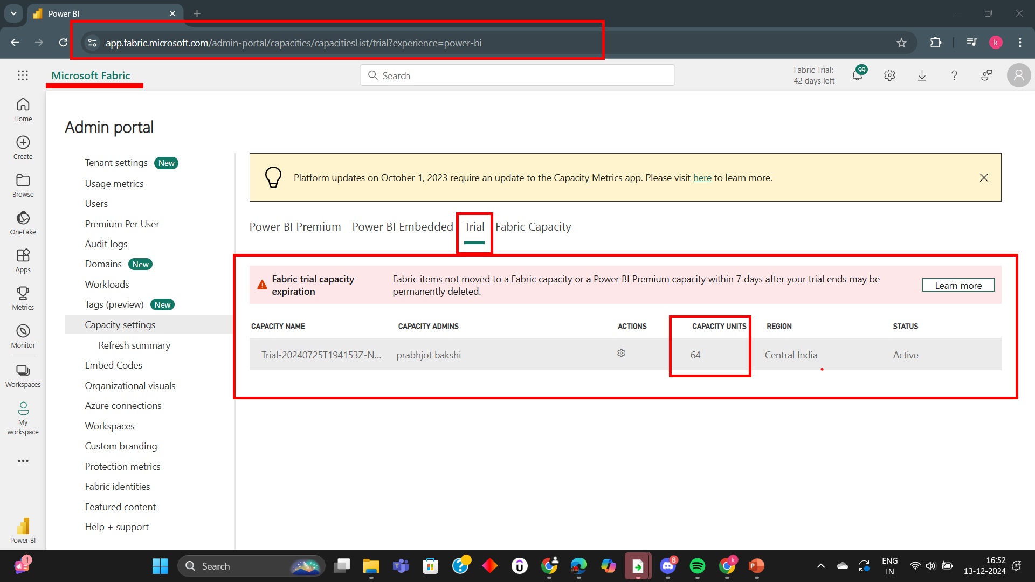

Slide 12
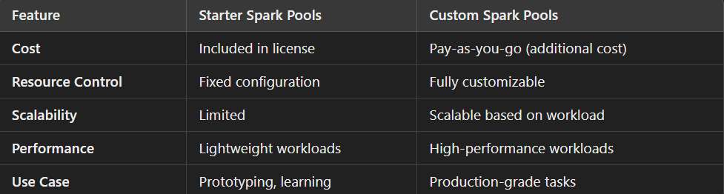
Starter Spark Pools v/s Custom Spark Pools

Slide 13
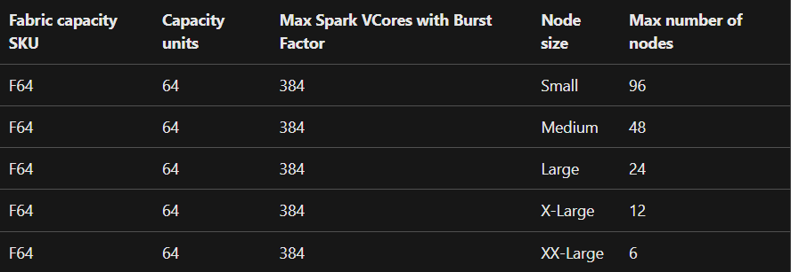
In Apache Spark, users get two Apache Spark VCores for every capacity unit they reserve as part of their SKU. One Capacity Unit = Two Spark VCores So F64 => 128 Spark Vcores and on which a 3x Burst Multiplier is applied which gives a total of 384 Spark VCores

Slide 14
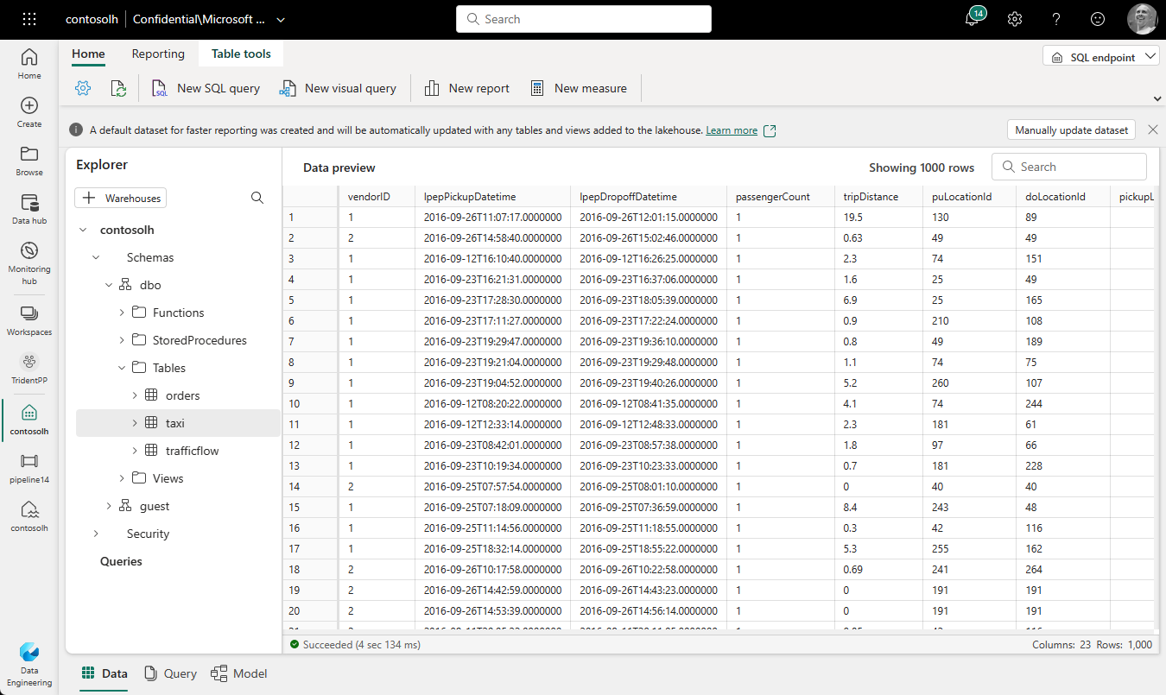
SQL Analytics Endpoint in Lakehouse
Microsoft Fabric provides a SQL-based experience for lakehouse Delta tables. This SQL-based experience is called the SQL analytics endpoint. You can analyze data in Delta tables using T-SQL language, save functions, generate views, and apply SQL security.
Creating a lakehouse creates a SQL analytics endpoint, which points to the lakehouse Delta table storage. Once you create a Delta table in the lakehouse, it's available for querying using the SQL analytics endpoint.

